Slide 1
Capstone
Project - Recommendation System
Group 5 - WONG, Shing Fung (Dov)

Slide 2
Objective
Study and discover the behavior patterns of e-commerce users, and visualize the findings.
Develop recommendation systems to recommend the products to those users.

Slide 3
Table of Contents
01
02
03
04
05
06
Dataset Introduction
Data Preprocessing
EDA
Recommendation System
Exploratory Data Analysis
Content based, Collaborative
Challenges and Limitations
Future Work

Slide 4
01
Dataset Introduction

Slide 5
Dataset Introduction
Kaggle - Retailrocket recommender system dataset
events.csv
category_tree.csv
item_properties_part1.csv
Item_properties_part2.csv

Slide 6
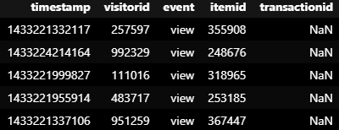
Dataset Introduction - event
timestamp - Unix Timestamp ← Will convert later
visitorid
event
view
addtocart
transaction
itemid
transactionid
Only exist when ‘event’ = ‘transaction’

Slide 7
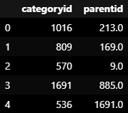
Dataset Introduction - category_tree
categoryid
parentid
Not all category have parent

Slide 8
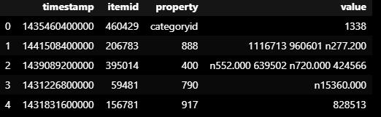
Dataset Introduction - item_properties
timestamp
itemid
property - Time based, 3 types
“categoryid” -> “value” will show categoryid
“available” -> “value” will show 1 (available) or 0 (unavailable)
Numeric value -> property (unknown meaning)
value - hashed data (unknown meaning)
String -> integer
Numeric value -> add “n” at the beginning and have 3 digits precision after decimal point.

Slide 9
02
Data Preprocessing

Slide 10
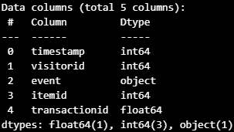
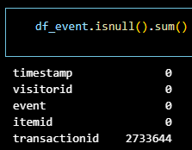
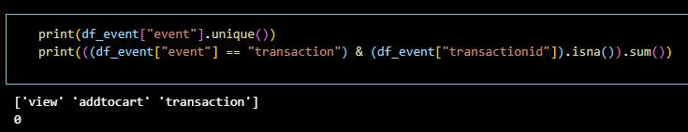
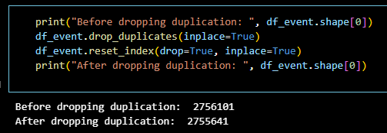
Data Preprocessing
Info
Check missing value
Drop duplication
No missing transactionid

Slide 11
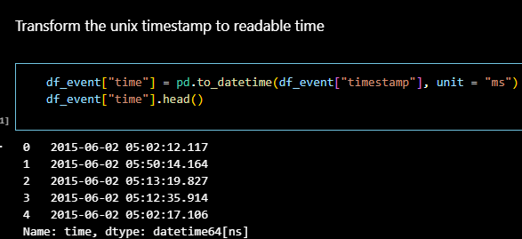
Data Preprocessing(con’t)
Transform the unix timestamp to readable time

Slide 12

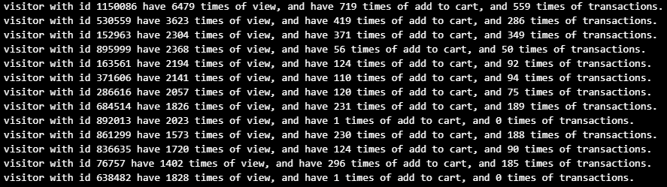
Data Preprocessing(con’t)
Try to identify abnormal users, windows shoppers and outliers

Slide 13
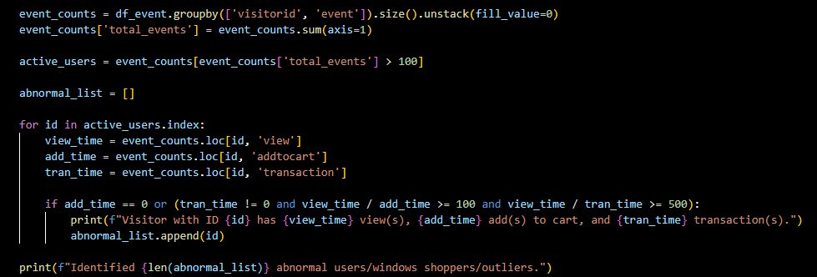
Data Preprocessing(con’t)

Slide 14
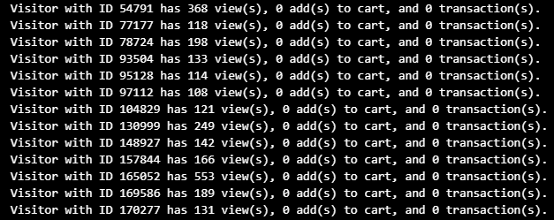

Data Preprocessing(con’t)
Some results
Drop the visitorid found

Slide 15
03
EDA (Exploratory Data Analysis)

Slide 16
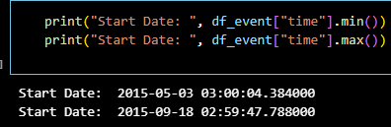
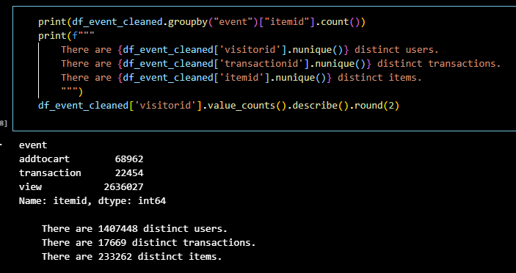
EDA
Time period of dataset:
2015-05-03 03:00 to 2015-09-18 02:59
2636027
View
Add to cart
Transaction
68962
From view: (2.62%)
22454
From view: (0.85%)
From cart: (32.56%)

Slide 17
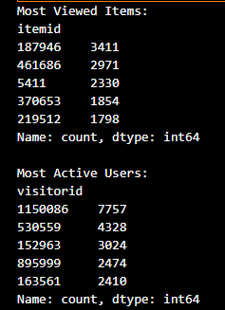
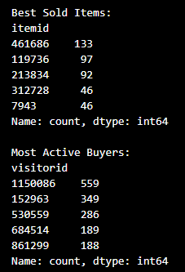
EDA

Slide 18
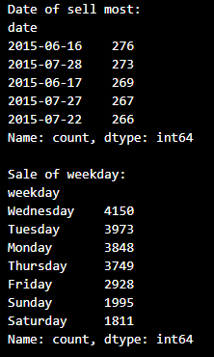
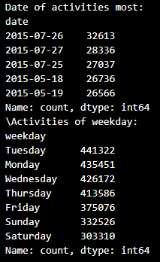
EDA

Slide 19

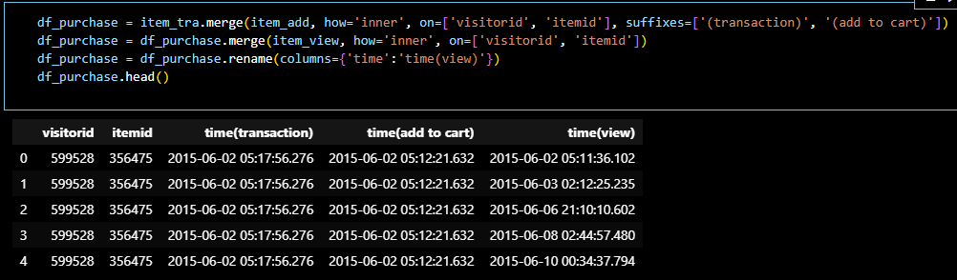
EDA - Average view before purchase
Breakdown the “event” into three separate data frame (view, addtocart, transaction)
Inner join these 3 data frame -> each transacted item will have time for transaction, add to cart, and view.

Slide 20
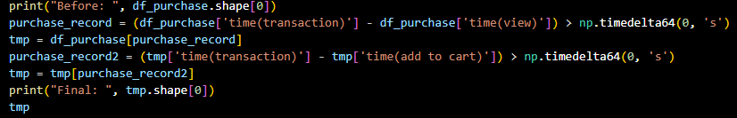
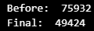
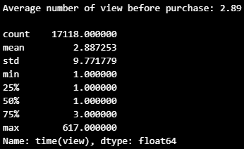
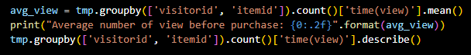
EDA - Average view before purchase
Keep the row only time for transaction > add to cart > view
Groupby ‘visitorid’ and ‘itemid’ and get the information about it

Slide 21
EDA - Average view before purchase
Keep the row only time for transaction > add to cart > view
Groupby ‘visitorid’ and ‘itemid’ and get the information about it

Slide 22
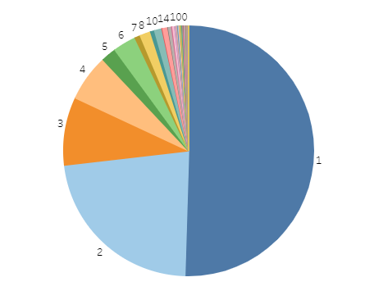
EDA - Average view before purchase
Tableau: https://public.tableau.com/app/profile/shing.fung.wong/viz/CapstonePRoject/Distribution?publish=yes

Slide 23
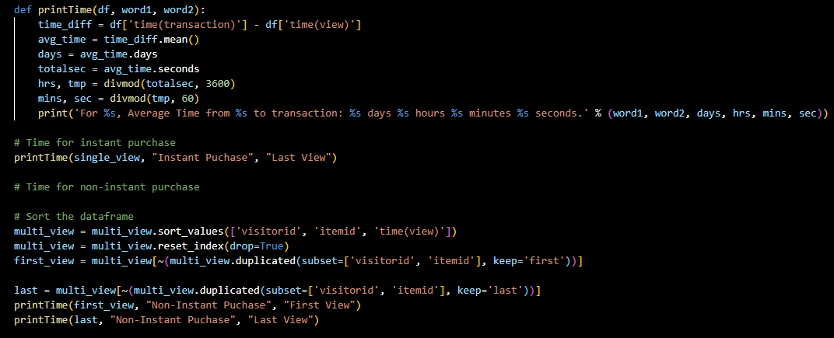

EDA - Average time before purchase

Slide 24
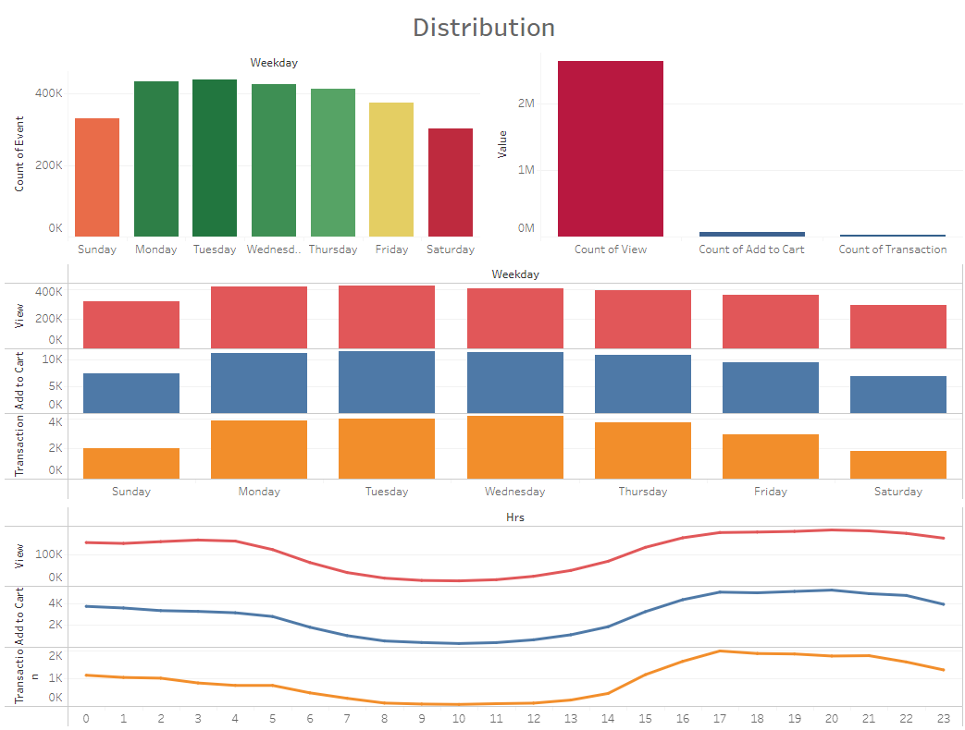
EDA - Distribution of event

Slide 25
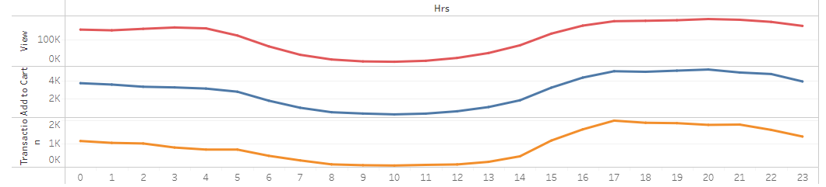

EDA - Distribution of event (con’t)
After lunch, people tend to not to work, but start to shop?

Slide 26
04
Recommendation System

Slide 27
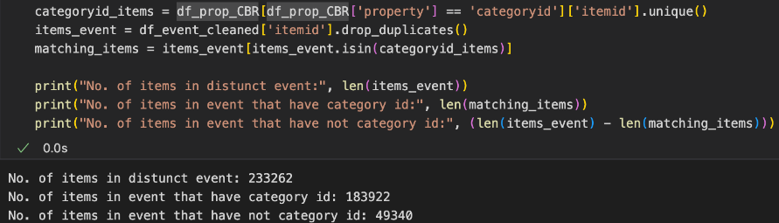
Recommendation - Content Based
Data Preprocessing
Drop the rows if “property” = “available”
Drop “timestamp”
Drop duplication
Drop the rows if “property” = “categoryid”
Reason: About 20% of items have not this row

Slide 28
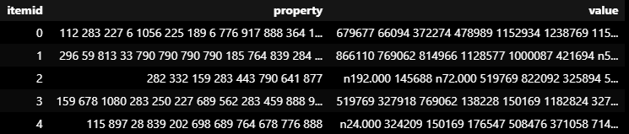
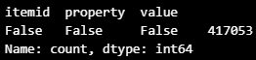
Recommendation - Content Based
Feature Engineering
Groupby “itemid” and aggregate property and value
Check null

Slide 29



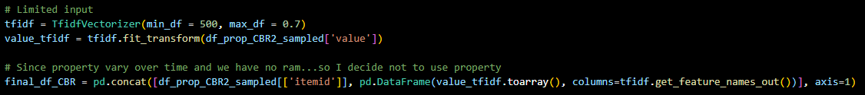
Recommendation - Content Based
Limitation of computing resources…
Sampling (1/10)
Set limitation when vectorize
Use “value” only
Vectorize -> Convert text to number

Slide 30
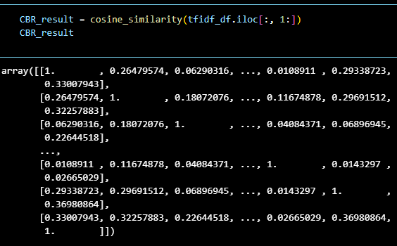
Recommendation - Content Based
Implement Cosine Similarity Algorithm -> Find similarity based on “value”

Slide 31

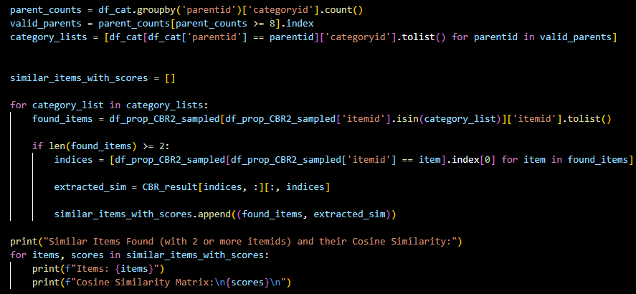
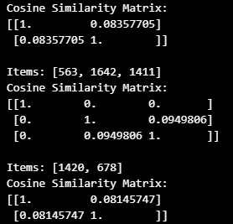
Recommendation - Content Based
Try to validate the result (Highly similar if the value is closer to 1)
Find the categoryid under same parentid
Compare their similarity (Suppose they are similar under same parent…)
FAIL!

Slide 32

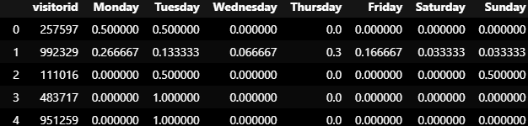
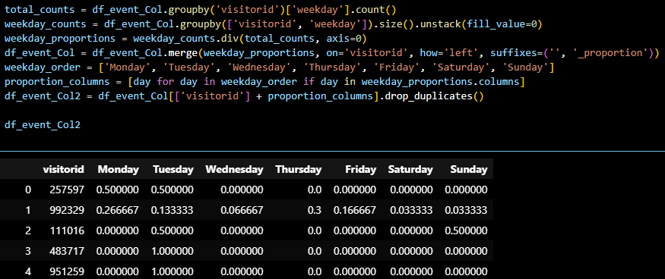
Recommendation - Collaborative Filtering
Data Preprocessing (Use weekday as the only feature)
Drop all unnecessary columns
Feature Engineering
Break up into 8 columns (Monday to Sunday & Activity Count)
Convert count into proportion

Slide 33


Recommendation - Collaborative Filtering
Limitation of computing resources again…
Sampling (1/100)
Implement MinMaxScaler to convert “Activity Count” into value from 0 to 1
Implement Cosine Similarity Algorithm

Slide 34
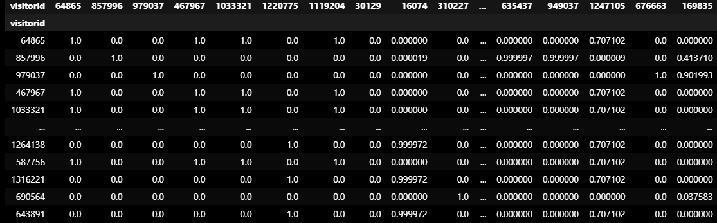
Result - Collaborative Filtering(a)
Use Mon - Sun & Activity Count
Too many 0 → Seems not good

Slide 35
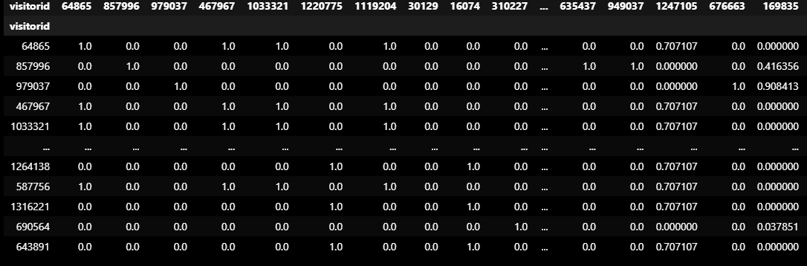
Result - Collaborative Filtering(b)
Use Mon - Sun only
Seems similar…

Slide 36
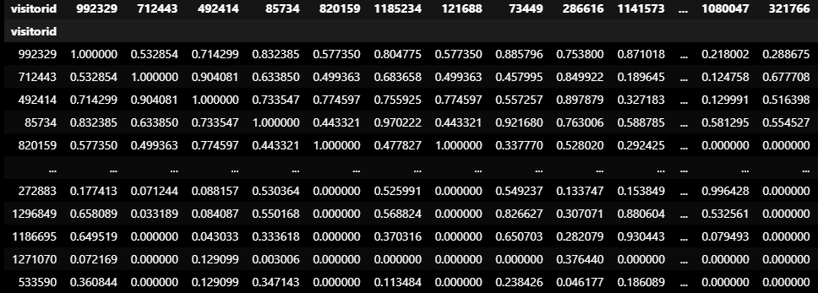
Result - Collaborative Filtering(c)
Drop users with activity count < 30 & use Mon - Sun only
Look good!!!

Slide 37
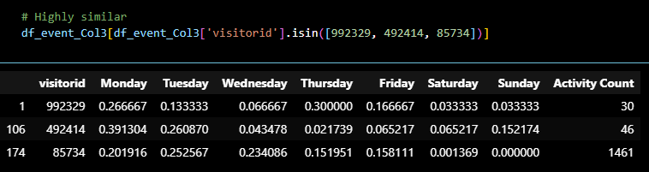
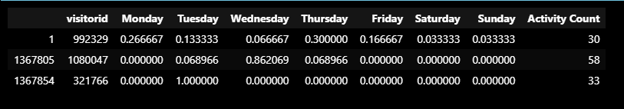
Validation- Collaborative Filtering(c)
Not sure is it similar….
Let Compare with low similarity

Slide 38
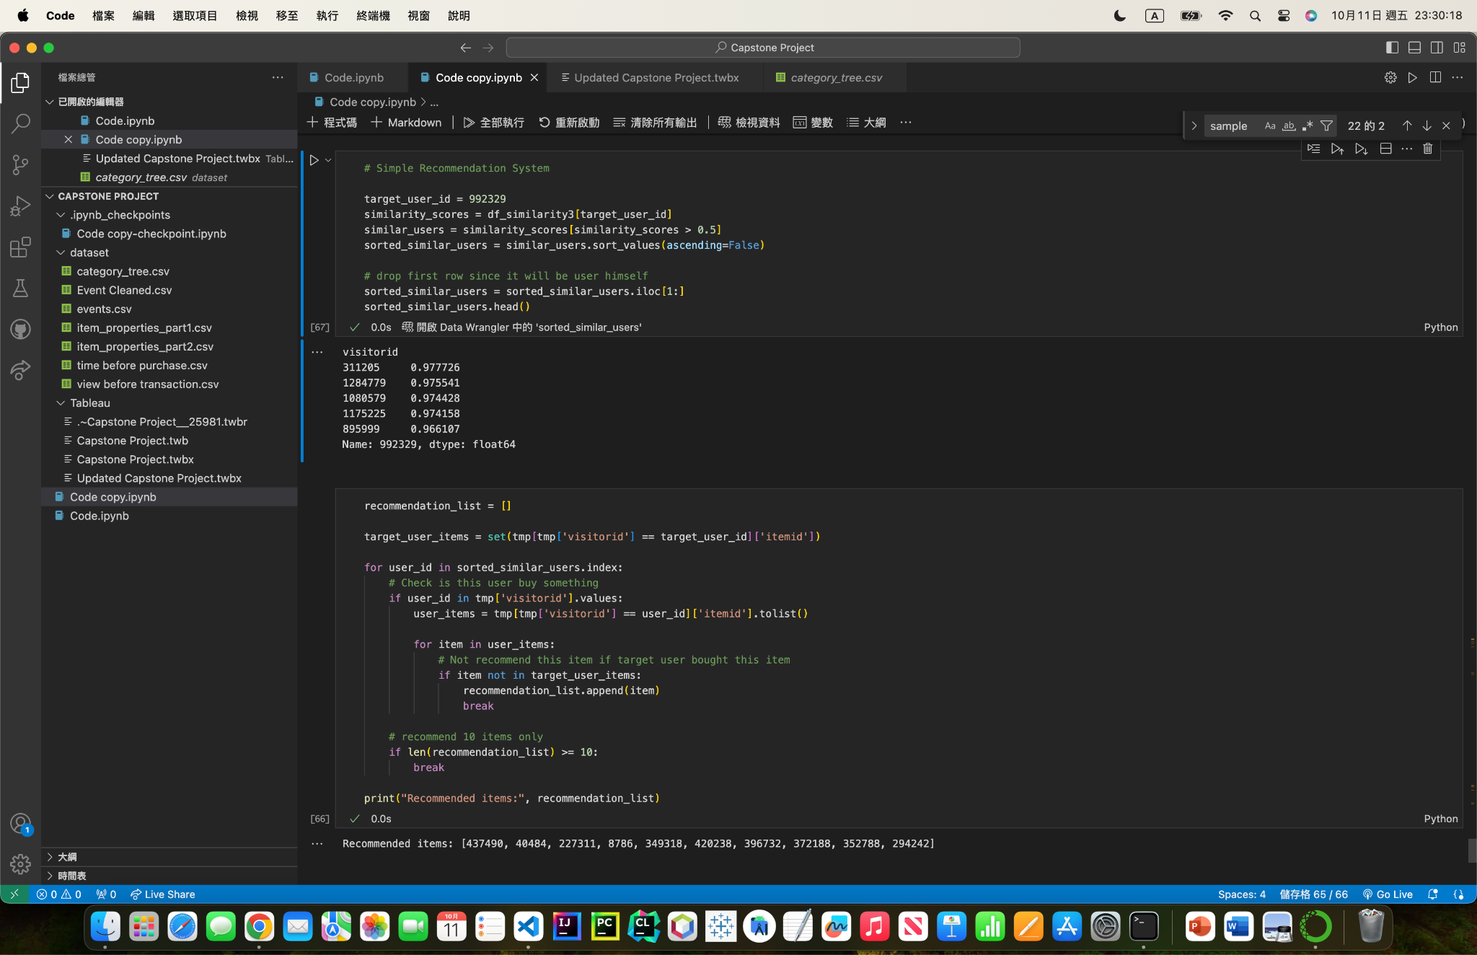
Simple Implementation of Recommendation System
Retrieve the list of visitorid with descending similarity
Recommend item based on the similar users

Slide 39
05
Challenges and Limitations

Slide 40
Challenges and Limitations
All values are unexplainable, I cannot use and analyze them effectively. Moreover, I cannot use them to validate my analysis.
There are too many category id missing. Category id can be a strong feature.
Value of “property” varies over time. Value of “value” cannot be interpreted. Aggregation may not be a good idea.
There are many features available. Due to limitation of resource and knowledge, it is hard to conduct complicated analysis.
The period of this dataset is too short. I cannot perform analysis related to time and trend.

Slide 41
06
Future Work

Slide 42
Future Work
Find a better dataset (i.e. Explainable values, cover longer period etc.)
Add more features or try other features for content based and collaborative filtering. For example, item popularity based, user-item interactions etc.
Develop a comprehensive recommendation system with integration of various algorithms.

Slide 43
07
Conclusion

Slide 44
Conclusion
The activity level of users is highest on Monday and Tuesday, and it is lowest on the weekends.
Users remains high activity level from 17:00 to 04:00.
Users will view the items about 3 times before purchase.
For instant purchase, it takes about 2 hours from view to transaction on average. For non-instant purchase, it takes 2 days 3 hours, and 3.5 hours from first view and last view to transaction respectively.
Content Based Filtering: Fail; Collaborative Filtering: Success

Slide 45
08
Reference

Slide 46
Reference
https://www.kaggle.com/code/kanncaa1/recommendation-systems-tutorial
https://www.kaggle.com/code/python4sp/rs-content-based-collaborative-filtering
https://www.kaggle.com/datasets/retailrocket/ecommerce-dataset

